Slide 1

Introduction to Server-Side Development -
Web 3

Slide 2
Server-Side Development
Server-side development involves the use of a programming technology like PHP or ASP.NET to create scripts that dynamically generate content
It is important to remember that when developing server-side scripts, you are still writing software
The major distinction is that your software runs on a web server and uses the HTTP requestresponse loop for most interactions with the clients
This distinction invalidates many classic software development patterns, and requires different thinking for many seemingly simple software principles like data storage and memory management

Slide 3
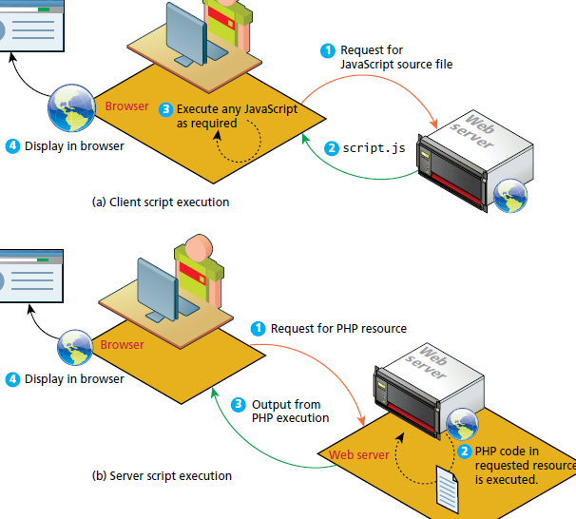
Comparing Client and Server Scripts
In a client-side script the code is executed on the client browser
In a server-side script, it is executed on the web server
The location of the script also impacts what resources it can access.
Server scripts cannot manipulate the HTML or DOM of a page in the client browser as is possible with client scripts.
A server script can access resources on the web server whereas the client cannot

Slide 4
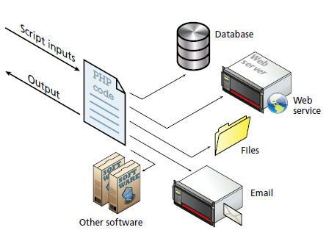
Server-side script resources
A server-side script can access any resources made available to it by the server
These resources can be categorized as
data storage
DBMS
web services
use the HTTP protocol to return XML or other data
software applications
authentication services
email

Slide 5
Comparing Server-Side Technologies
ASP (Active Server Pages): This was Microsoft’s first server-side technology (also called ASP Classic)
ASP.NET: This replaced Microsoft’s older ASP technology. ASP.NET is part of Microsoft’s .NET Framework and can use any .NET programming language (though C# is the most commonly used). ASP.NET uses an explicitly object-oriented approach. It is often used in larger corporate web application systems. It also uses special markup called web server controls that encapsulate common web functionality such as database-driven lists, form validation, and user registration wizards. A recent extension called ASP.NET MVC makes use of the Model-View-Controller design pattern. It is essentially limited to Windows servers.

Slide 6
Comparing Server-Side Technologies
JSP (Java Server Pages): uses Java as its programming language and uses an explicit object-oriented approach. It is used in large enterprise web systems and is integrated into the J2EE environment. Usage in the web as a whole is small, it has a substantial market share in the intranet environment
PHP: a dynamically typed language that can be embedded directly within the HTML, though it now supports most common object oriented features, such as classes and inheritance.
Perl: Until the development and popularization of ASP, PHP, and JSP, Perl was the language typically used for early server-side web development. As a language, it excels in the manipulation of text. It was commonly used in conjunction with the Common Gateway Interface (CGI), an early standard API for communication between applications and web server software.

Slide 7
Comparing Server-Side Technologies
Ruby on Rails. Web development framework that uses the Ruby programming language. It emphasizes the use of common software development approaches, in particular the MVC design pattern. It integrates features such as templates and engines that aim to reduce the amount of development work required in the creation of a new site.
ColdFusion. ColdFusion is a tag-based, back-end web language that has been around since the mid-1990′s. CFML compares to the scripting components of ASP, JSP, and PHP in purpose and features, but its tag syntax more closely resembles HTML, while its script syntax resembles JavaScript.

Slide 8
Comparing Server-Side Technologies
Node.js. This is a recent server environment that uses JavaScript on the server side, thus allowing developers already familiar with JavaScript to use just a single language for both client-side and server-side development. node.js is also its own web server software, thus eliminating the need for Apache, IIS, or some other web server software.
Django. A high-level free and open source Python Web framework that encourages rapid development and clean, pragmatic design. It follows the model – view – controller (MVC) architectural pattern.

Slide 9
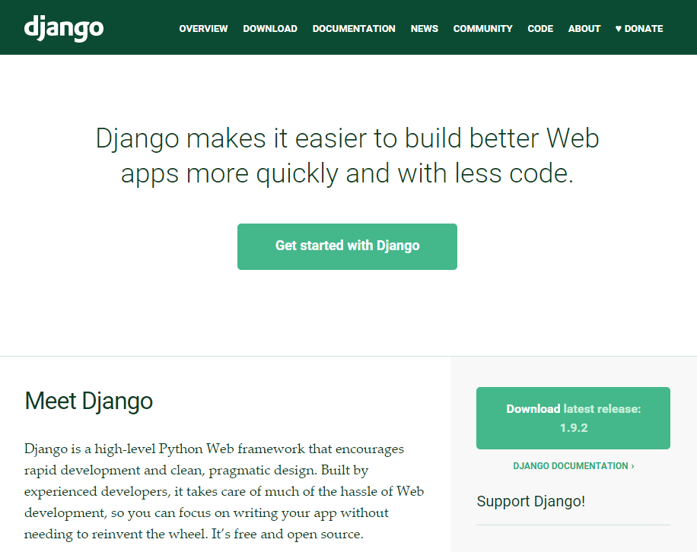
Django
https://www.djangoproject.com/

Slide 10
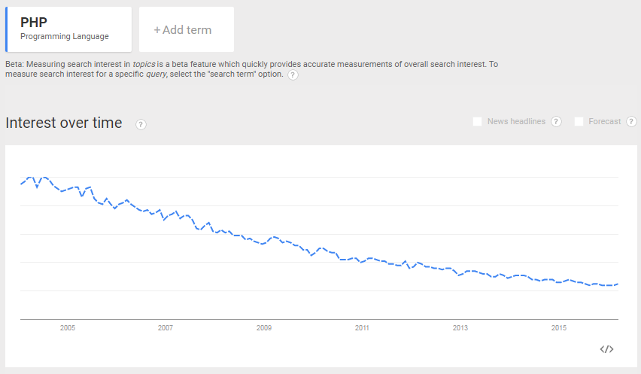
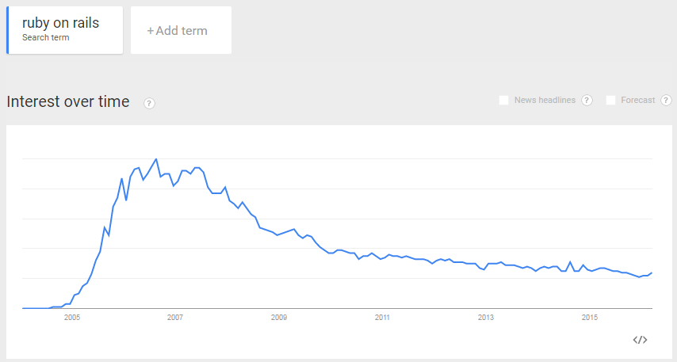
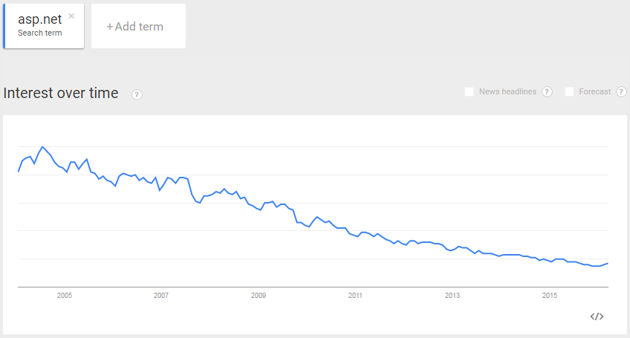
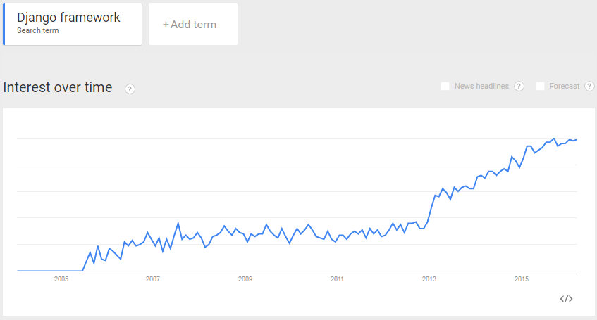
Why Django

Slide 11
Django overview
Django's primary goal is to ease the creation of complex, database-driven websites
Django emphasizes reusability and "pluggability" of components, rapid development, and the principle of don't repeat yourself (DRY)
Python is used throughout, even for settings, files, and data models.
Django also provides an optional administrative create, read, update and delete interface that is generated dynamically through introspection and configured via admin models.

Slide 12
Features
An object-relational mapper (ORM) that mediates between data models (defined as Python classes) and a relational database ("Model");
A system for processing HTTP requests with a web templating system
A regular-expression-based URL dispatcher A lightweight and standalone web server for development and testing
A form serialization and validation system that can translate between HTML forms and values suitable for storage in the database
A template system that utilizes the concept of inheritance borrowed from object-oriented programming
A caching framework that can use any of several cache methods
Support for middleware classes that can intervene at various stages of request processing and carry out custom functions
An internal dispatcher system that allows components of an application to communicate events to each other via pre-defined signals
An internationalization system, including translations of Django's own components into a variety of languages
A serialization system that can produce and read XML and/or JSON representations of Django model instances

Slide 13
Bundle applications
The main Django distribution also bundles a number of applications in its "contrib" package, including:
an extensible authentication system
the dynamic administrative interface
tools for generating RSS and Atom syndication feeds
a sites framework that allows one Django installation to run multiple websites, each with their own content and applications
tools for generating Google Sitemaps
built-in mitigation for cross-site request forgery, cross-site scripting, SQL injection, password cracking and other typical web attacks, most of them turned on by default

Slide 14
To sum up
Fast development: take a web application from concept to launch in a matter of hours
Fully loaded: Django includes dozens of extras you can use to handle common Web development tasks.
user authentication
content administration
site maps
RSS feeds
Security: helps developers avoid many common security mistakes
SQL injection
cross-site scripting
cross-site request forgery
Clickjacking
Scalable: ability to quickly and flexibly scale to meet the heaviest traffic demands

Slide 15
Sites using Django
https://www.instagram.com/
https://www.washingtonpost.com/
https://www.nasa.gov/
http://www.nationalgeographic.com/
https://www.mozilla.org/en-US/
http://www.theonion.com/
https://www.pinterest.com/
https://prezi.com/
https://bitbucket.org/
https://www.chess.com/
https://www.redditgifts.com/
https://disqus.com/

